Slide 1

Surgeon’s Neck Posture during Spine Surgeries: “The Unrecognized Potential Occupational Hazard”
Seminar Presentation
Zhen Hu (Group 8)
Team member: Zhen Hu, Hanqing Duan
Mentor: Dr. Russell Taylor, Dr. Deepa Galaiya

Slide 2
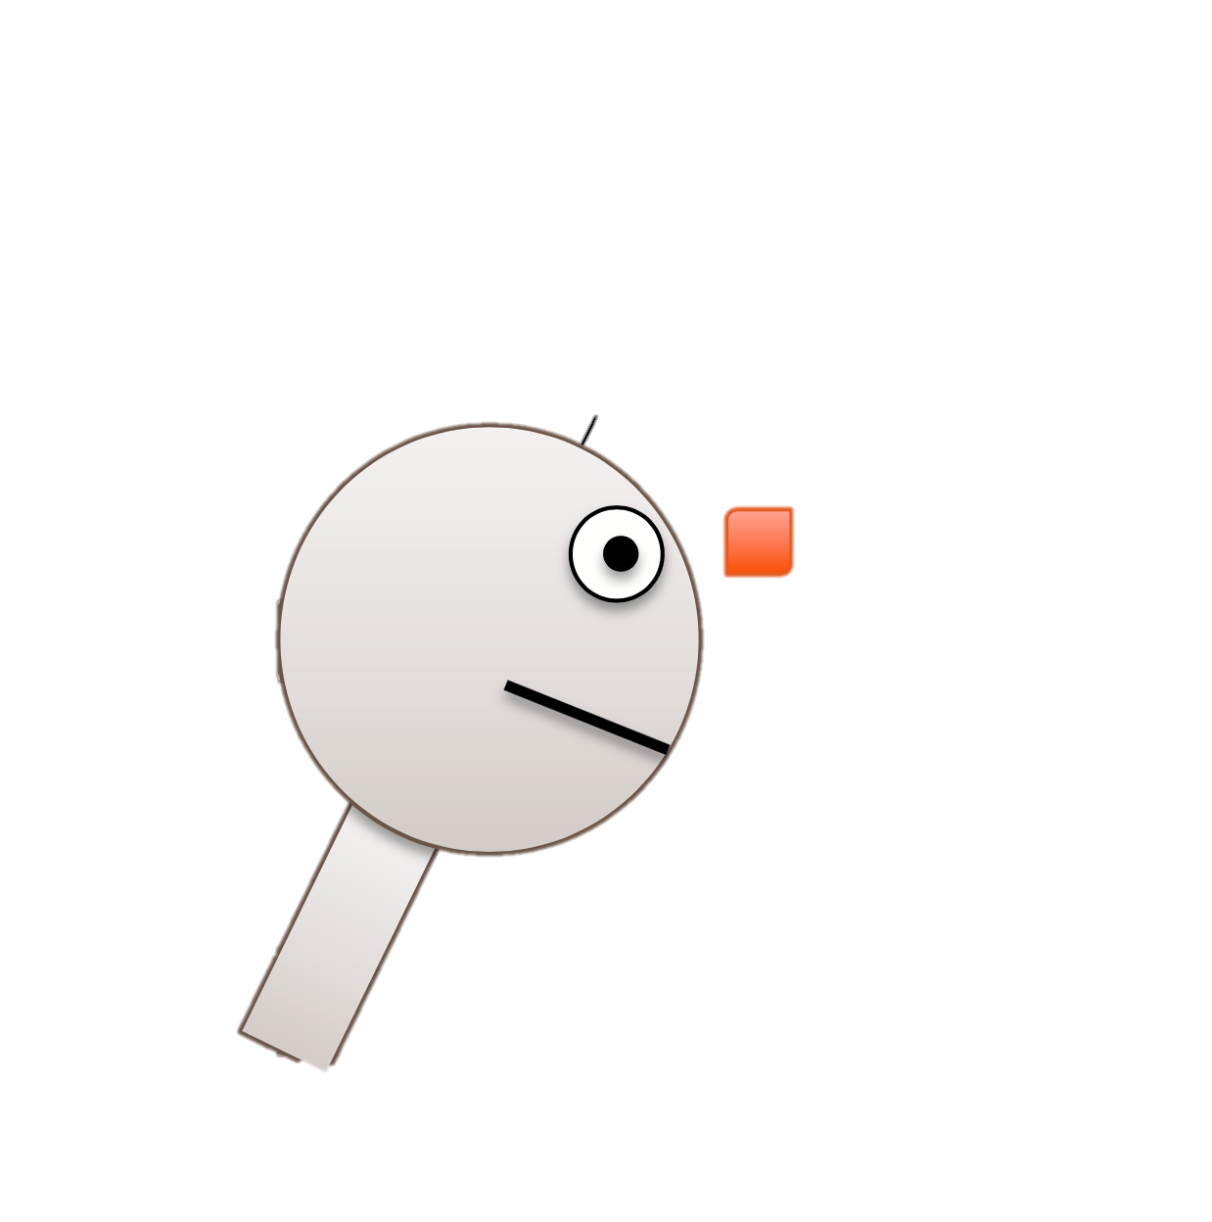



Project Summary
A6
Goal: Accurate Measurement of Neck Flexion Angle during Thyroid and Ear Surgery by using IMUs
IMU: Inertial measurement unit
Accurate: Calibrate IMUs’ pitch angle against EM tracker
Neck Flexion Angle: extract pitch angle between two IMUs
Surgeries: Analyze neck flexion angle changes in real surgical scenarios if possible
$$θ$$
1A
Figure Edit from: https://stanford.edu/class/ee267/lectures/lecture10.pdf
Notes:
To investigate and compare postural ergonomics of surgeons during two different surgical scenarios

Slide 3
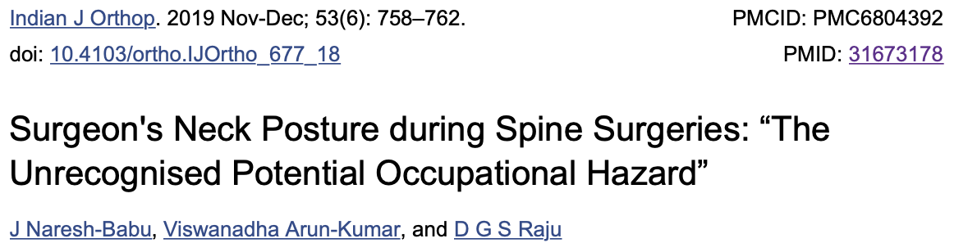
Paper Selection
After finishing the calibration and data analysis, our aim is to figure out what’s the data illustrate.
The paper gives a great discussion and conclusion on how to analyze the data and what people can learn from those data.
Screenshot from https://www.ncbi.nlm.nih.gov/pmc/articles/PMC6804392/

Slide 4
Paper Background
Forward head posture (FHP)
Purpose: analyze the surgeon’s neck postures while performing lumbar spinal surgeries.
Here are some terminologies may be used:
Head flexion angle (HFA)
Neck flexion angle (NFA)
Cervical angle (CA)
Transforaminal lumbar interbody fusions (TLIFs)
Lumbar decompression (LD)

Slide 5
Methodology
Methods to evaluate spinal posture have been categorized into four groups:
Radiography.
Three-dimensional motion analysis.
Video raster stereography analysis.
Photographic posture analysis: Basic objective observational measurement method using anatomical landmarks.
25 TLIFs
60 videos performed by three spine surgeons
15 with headlight
35 LD
Snapshots of the video were taken whenever the surgeon changes his/her position and using Surgimap (Spine Software).
All images are calibrated.
20 with microscope

Slide 6
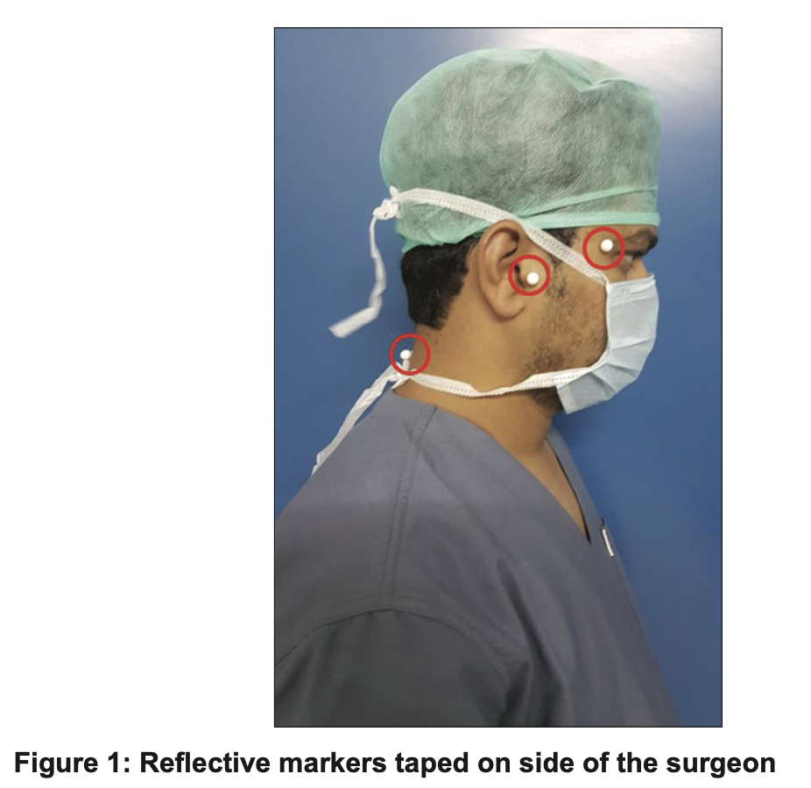
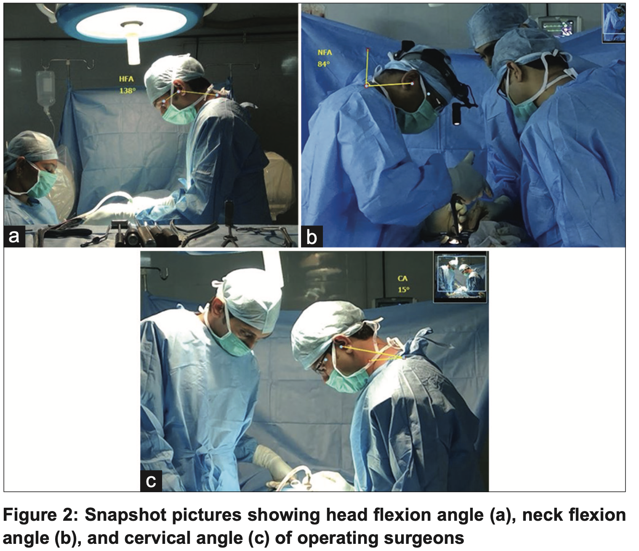
Experiment
Figures from https://www.ncbi.nlm.nih.gov/pmc/articles/PMC6804392/
Three reflective markers were taped on the side of the surgeons
The whole surgery can be divided into different phases: exposure, fixation, decompression, fusion, and closure.

Slide 7
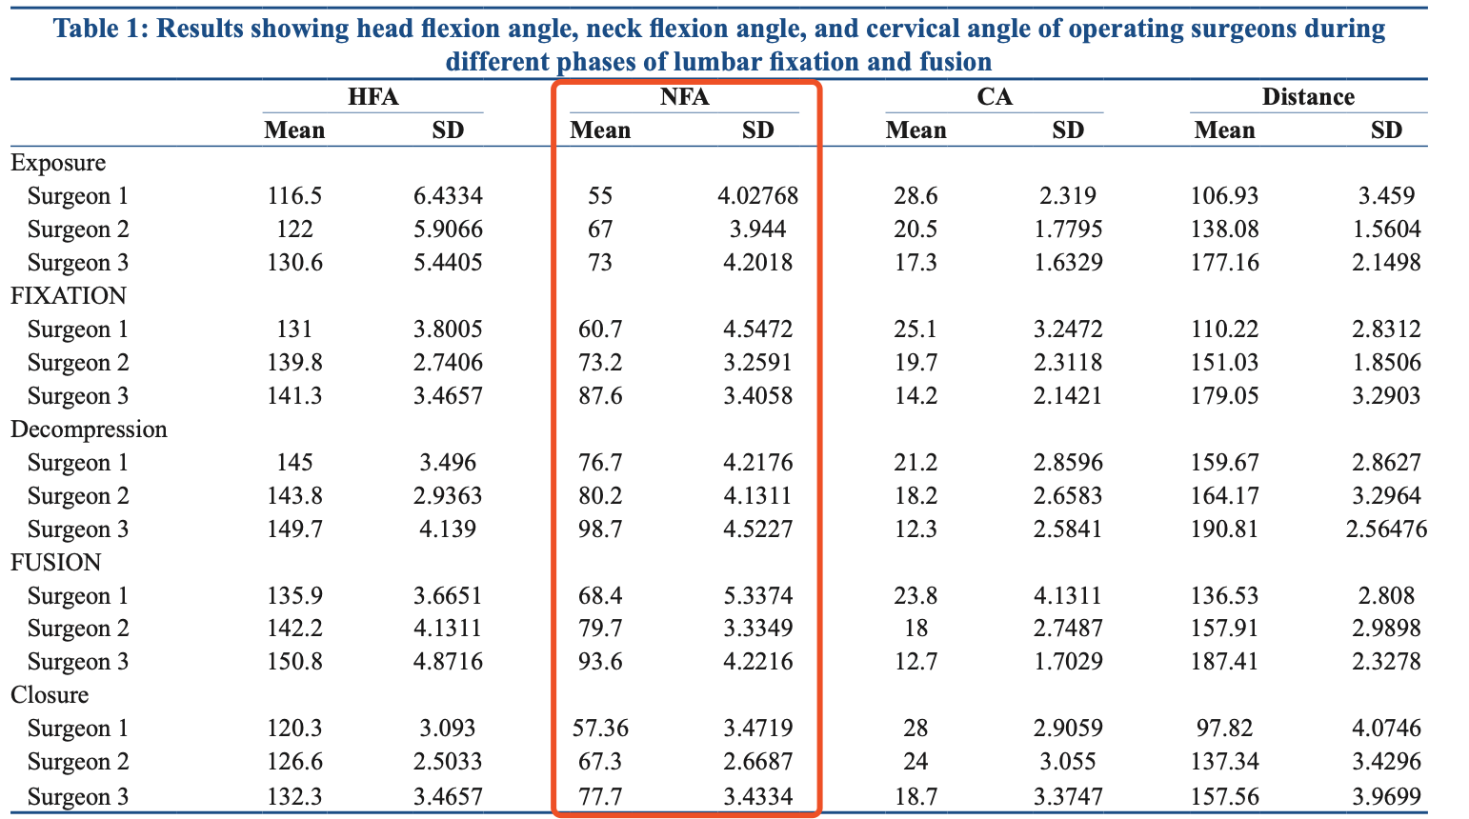
Result
Figures from https://www.ncbi.nlm.nih.gov/pmc/articles/PMC6804392/
Red is what we are interested in: neck flexion angles.
Decompression and fusion are the most stressful phases affecting surgeon’s neck.
HFA and NFA were significantly higher during decompression and fusion when compared with exposure and closure (P < 0.05).
NFA seems to be abnormal in decompression and fusion. In other phases they nearly satisfy the normal distribution.

Slide 8
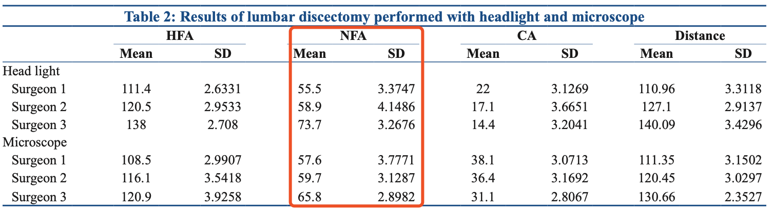
Result
Figures from https://www.ncbi.nlm.nih.gov/pmc/articles/PMC6804392/
Red is what we are interested in: neck flexion angles.
HFA and NFA did not alter much in the headlight and microscope groups, while CA showed significant difference (P < 0.001).

Slide 9
Discussion & Conclusion
Correct upright posture: ears are aligned with the shoulders in the same line, leading to least strain on the back.
When neck flexion is at neural position, the weight load of head on spine is 10-12 lbs.
When NFA increase from 0° to 60°, the weight increased to 60 lbs.
When NFA bigger than 60°, load could not be calculated since the module become unstable.
In the present study, load has been consistently above 60 lbs during all the phases of surgery.
The usage of microscope was found to be beneficial.

Slide 10
Assessment
This paper is very informative on data analysis and conclusion. Several method we can learn from the paper:
Divide the whole surgery into different phases, calculate the mean and SD of each phase.
After getting the histogram representation of the neck flexion angles, we can try to fit the curve with normal distribution if possible.
When doing comparison, calculate the p-value to show whether the null hypothesis is convincing or not.

Slide 11
Assessment
About the technical approach, there are some drawbacks:
Didn’t show specifically how to calibrate the images. The calibration process can influence the reliability of the data.
Didn’t show how many snapshots of the video have been taken. The condition that whenever the surgeon changes position, taking a snapshot seems a little ambiguous.
The data gathered from this method aren’t continuous, if the surgeon move to another direction, the opposite direction of the camera, then the camera can’t gather any data.

Slide 12
Thanks!

